Slide 1
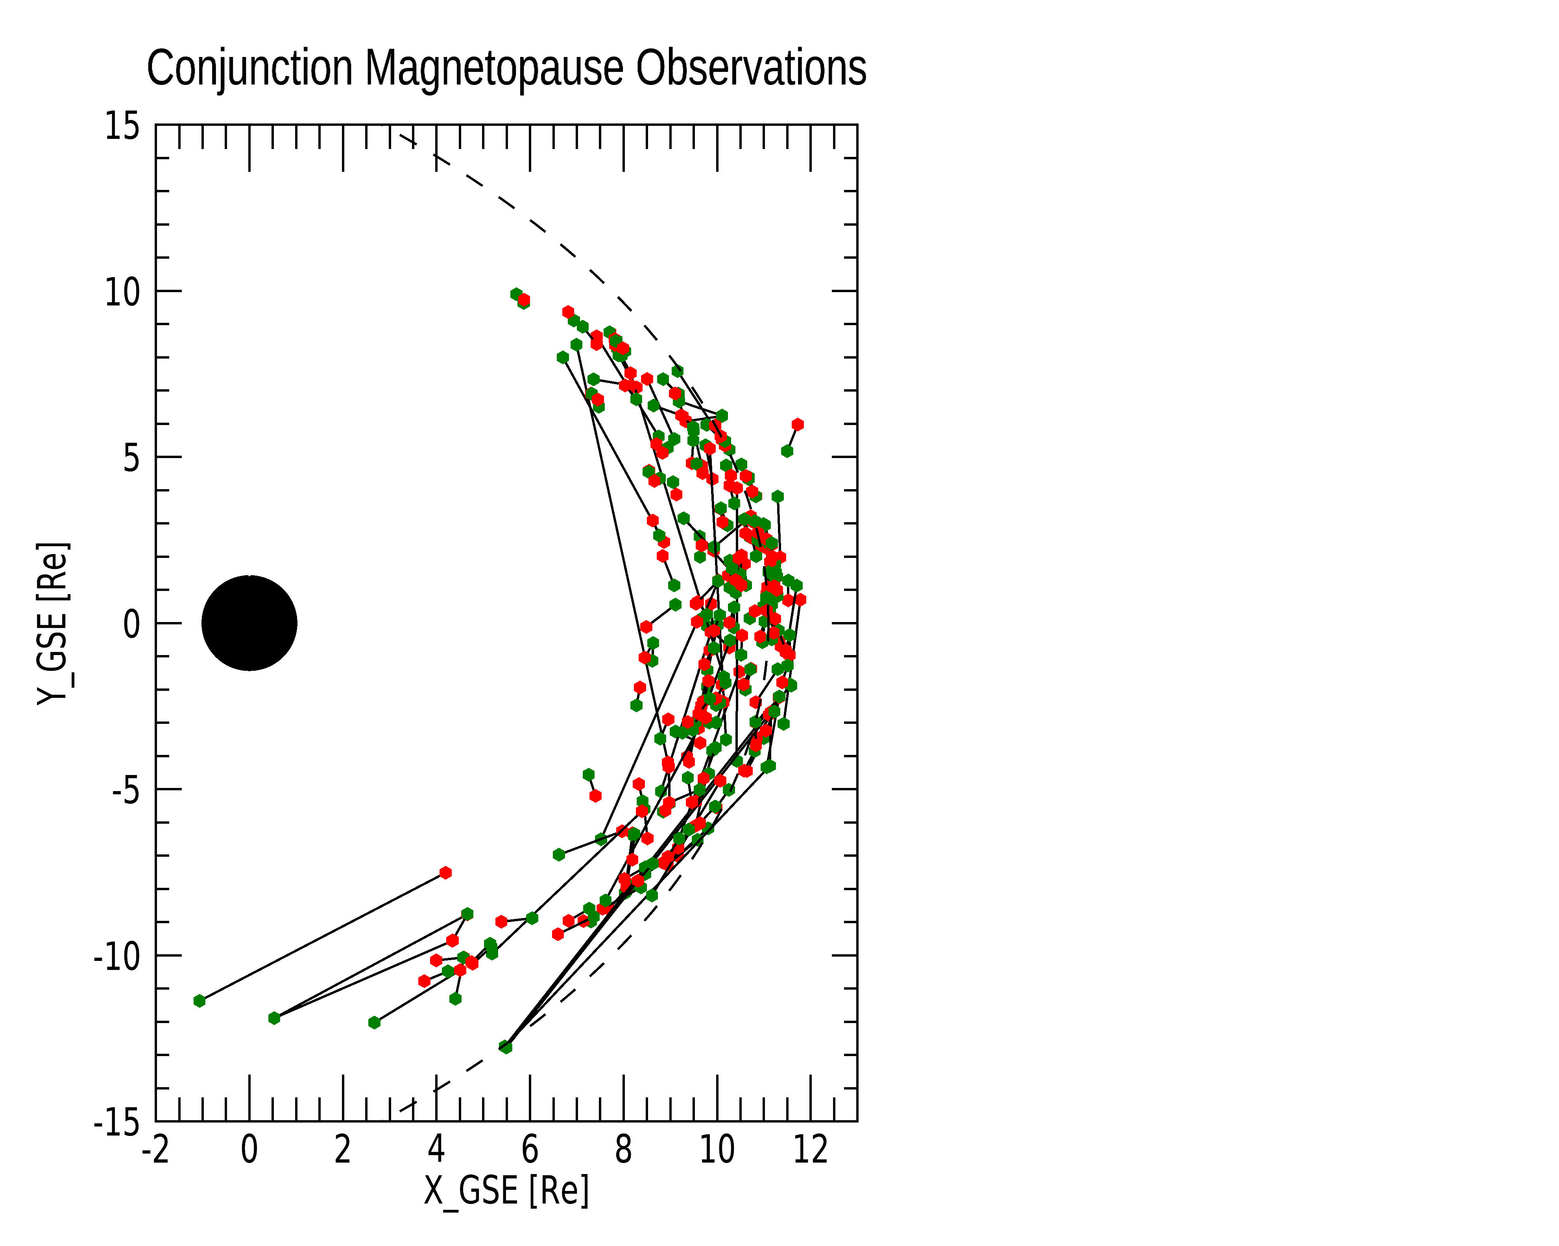
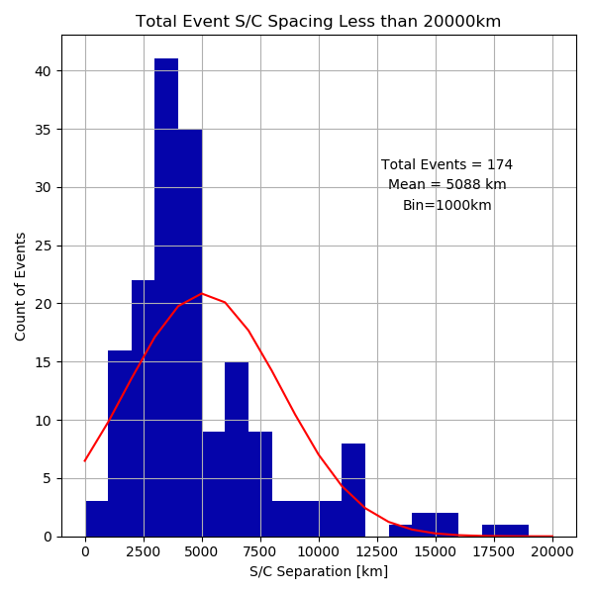
Statistical study of the spatial extent of magnetopause reconnection as observed by THEMIS
WHAT:
Emil Atz, Brian Walsh, Jef Broll, Ying Zou
THEMIS satellites have crossed the magnetopause many many times and can be used to detect the presence of reconnection. (e.g. McFadden 2008, Trattner 2012, Walsh 2014, Phan 2013, 2016, Zou 2018, 2022)
Conjunction observations with 2 satellites are used to define the spatial extent of reconnection.
(e.g. Phan 2000 ,Dunlop 2011, Walsh 2017, Zou 2019, 2020)
WHEN:
Timeframe: 2008-2010, continuing with 2013-...
emilatz@bu.edu
1

Slide 2
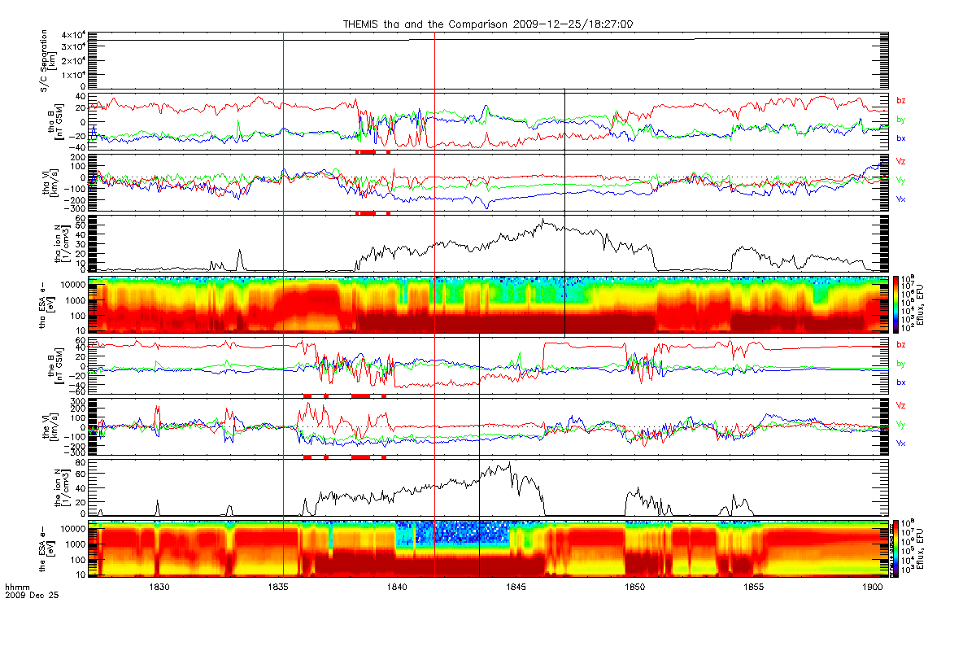
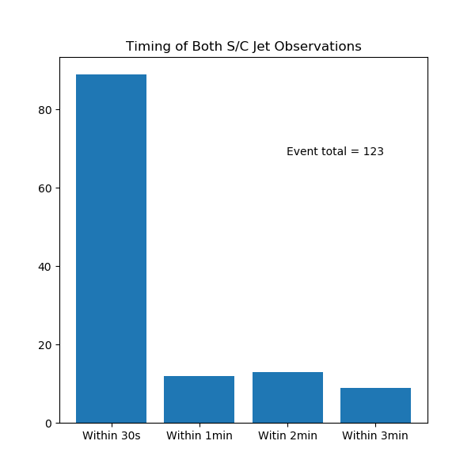
Statistical study of the spatial extent of magnetopause reconnection as observed by THEMIS
HOW:
Emil Atz, Brian Walsh, Jef Broll, Ying Zou
2 satellite conjunction observations are detected with analyzing monthly Bz data
Crossings are tested versus the Walen Relation:
A comparison of observed/theoretical jet speeds, agreement = reconnection jet
Timing of Both S/C Jet Observations
Satellite 1 (thm_a)
Event total 123
Satellite 2 (thm_e)
Within 30s
Within 60s
Within 120s
Within 180s
Walen Relation detects reconnection jets
emilatz@bu.edu
2

Slide 3
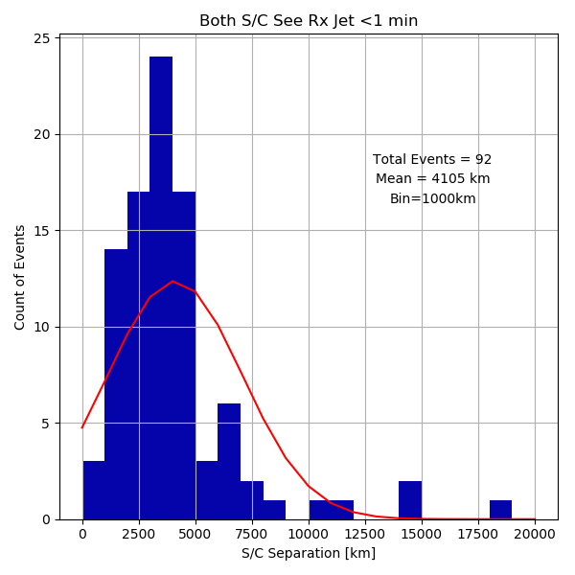
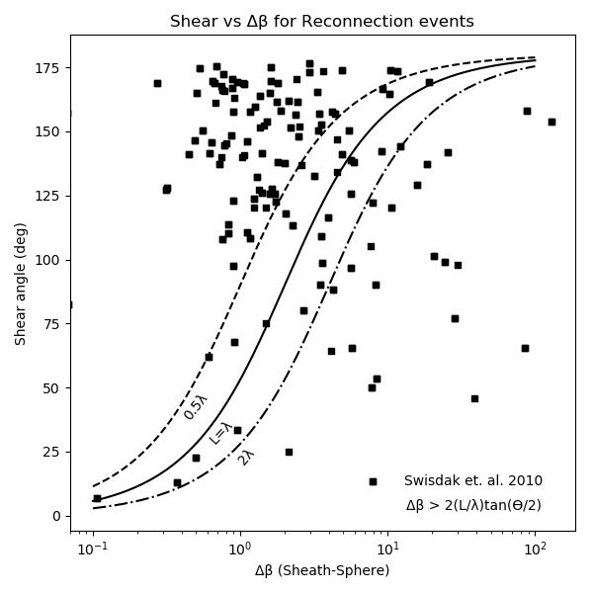
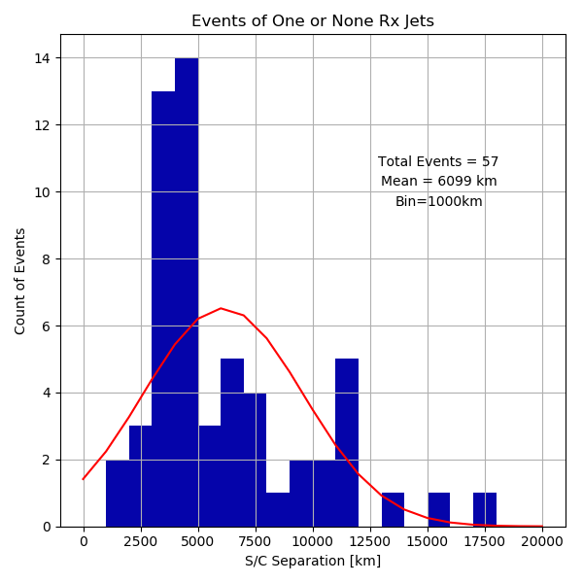
Statistical study of the spatial extent of magnetopause reconnection as observed by THEMIS
WHY:
Emil Atz, Brian Walsh, Jef Broll, Ying Zou
Because magnetopause imaging is not yet available, statistics of many observations is our best path to characterize the causes of different reconnection drivers.
Knowing both the EXTENT of reconnection and what CAUSES different types of reconnection will help quantify the energy transfer into the magnetosphere.
Both see Rx Jet <1min
Mean 4105km
Events of One or None see Rx Jet
Mean 6099km
Agreement with Phan et. al. 2013
emilatz@bu.edu
3

