Slide 1
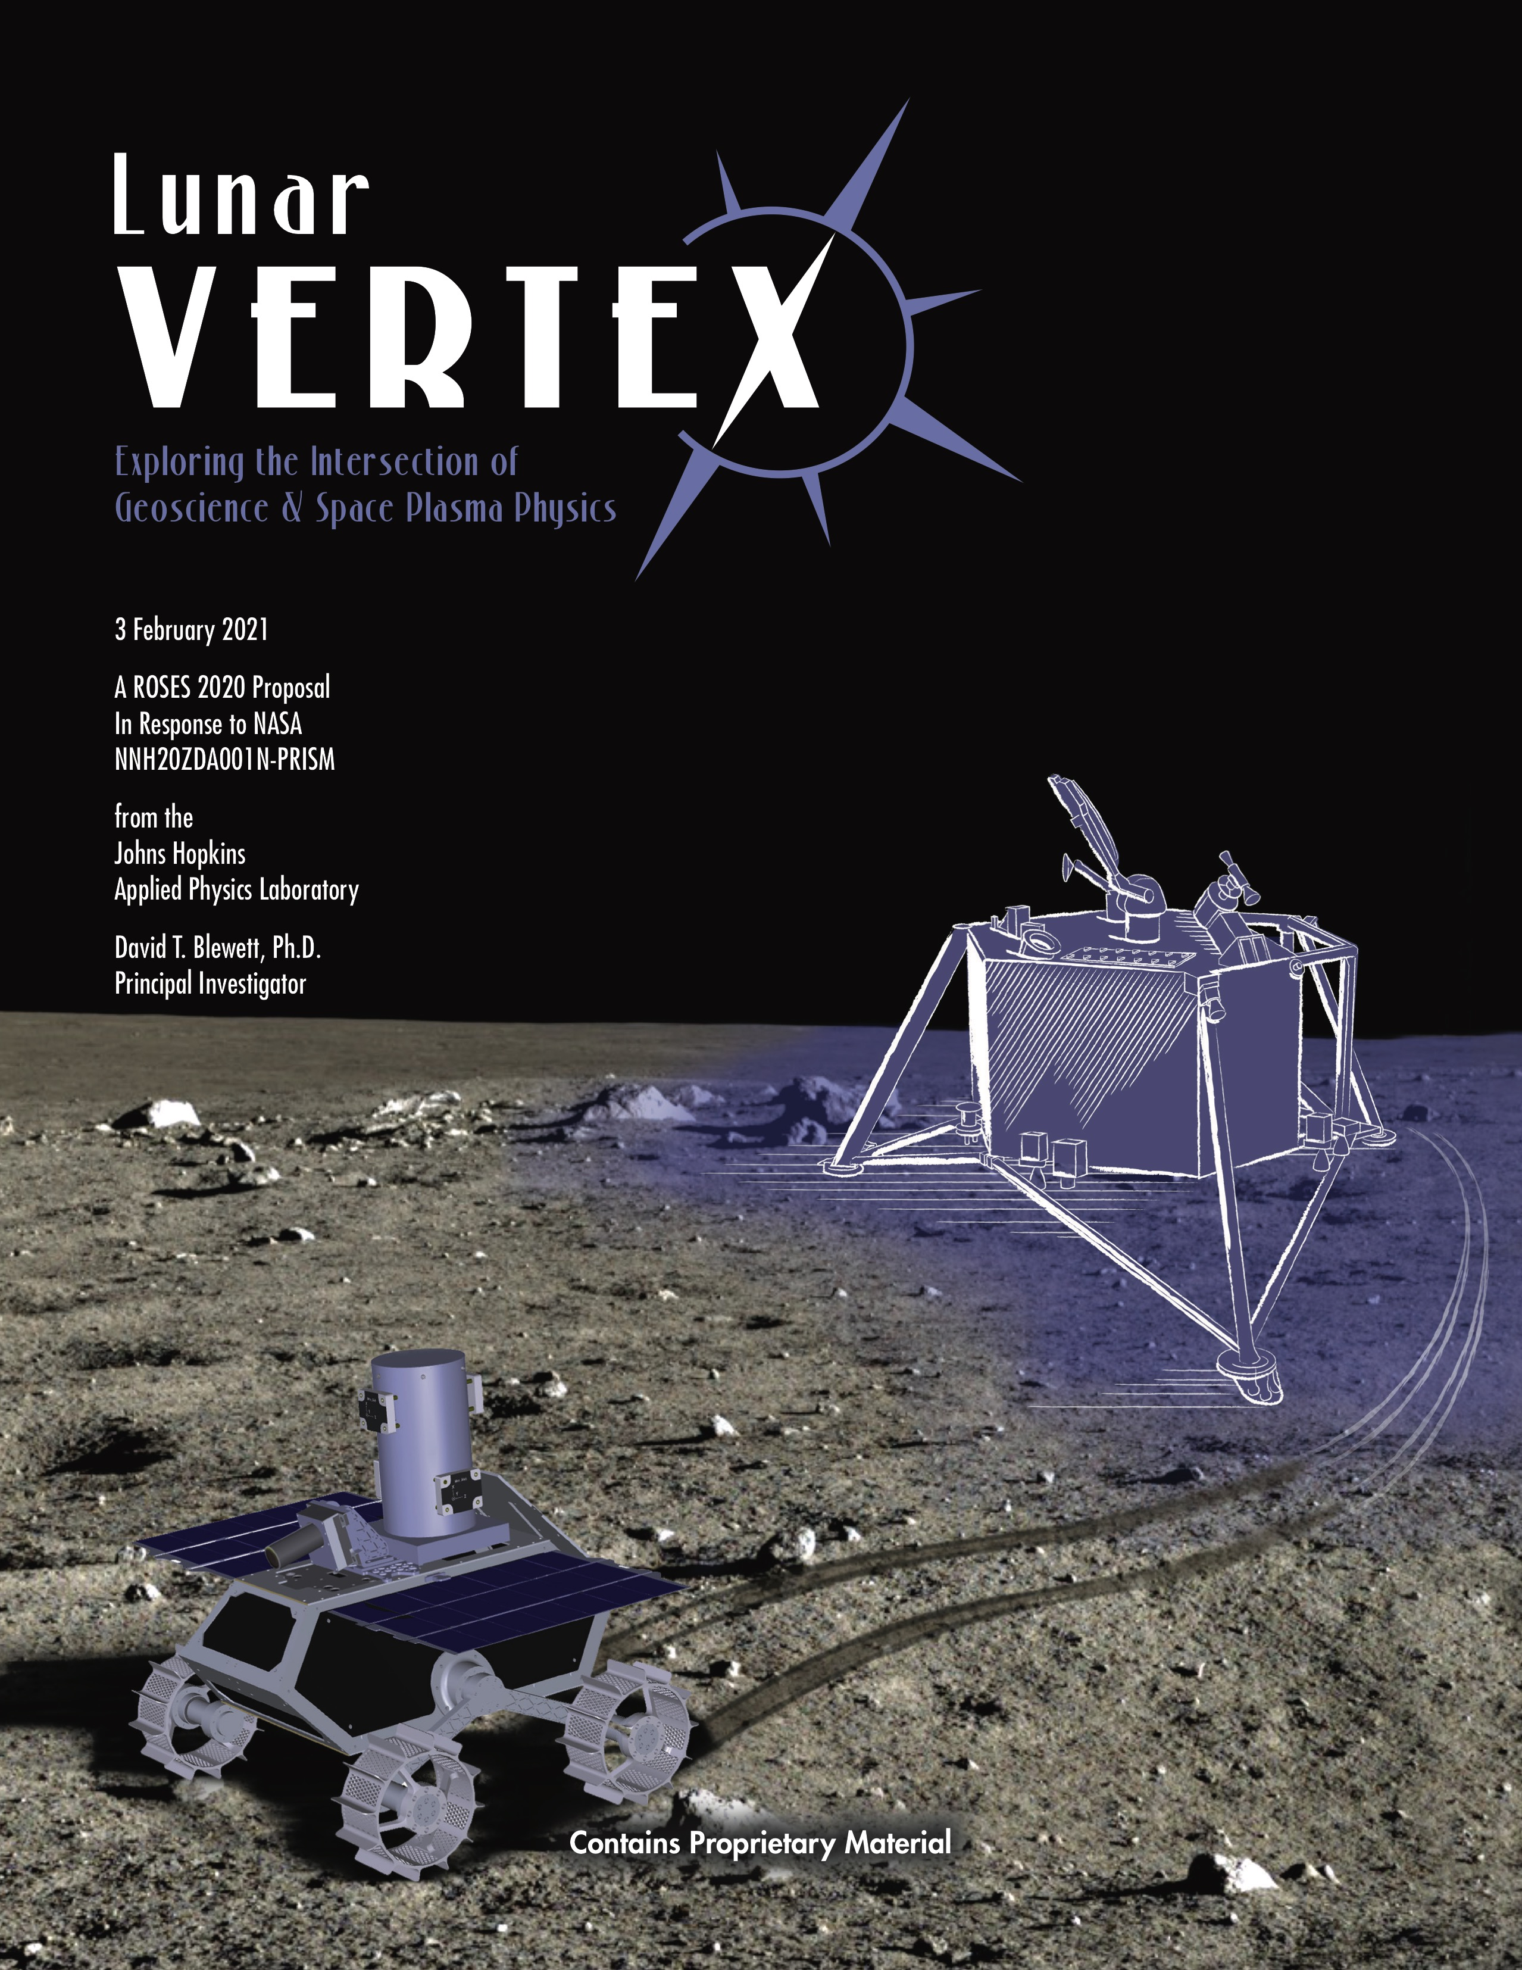
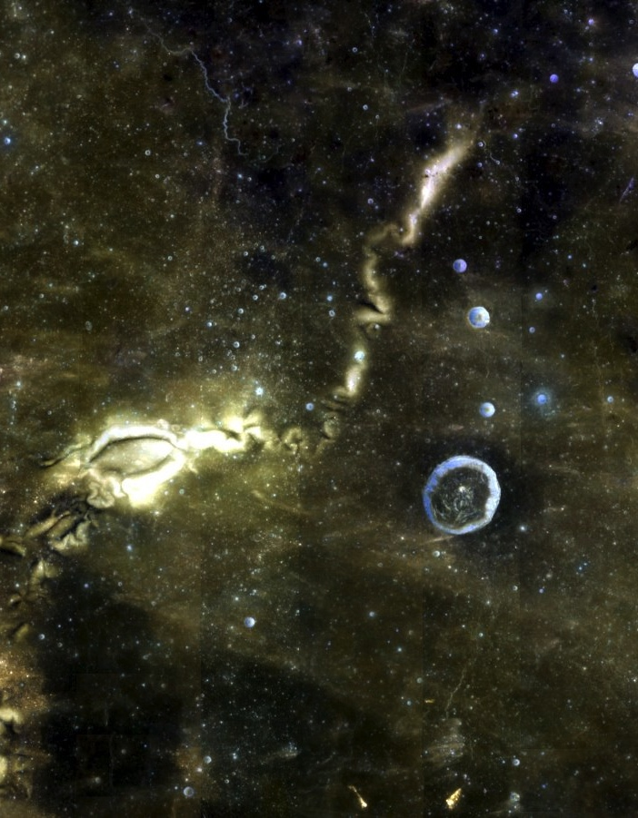
Lunar Vertex
Exploring the Intersection of Geoscience & Space Plasma Physics
Reiner Gamma
Where do the Moon’s magnetic fields come from?
What produces lunar “swirls”?
How does the solar wind interact with lunar magnetic fields?
How does the space environment weather planetary surfaces over time?
Selected June 2021
Launch April 2024

Slide 2
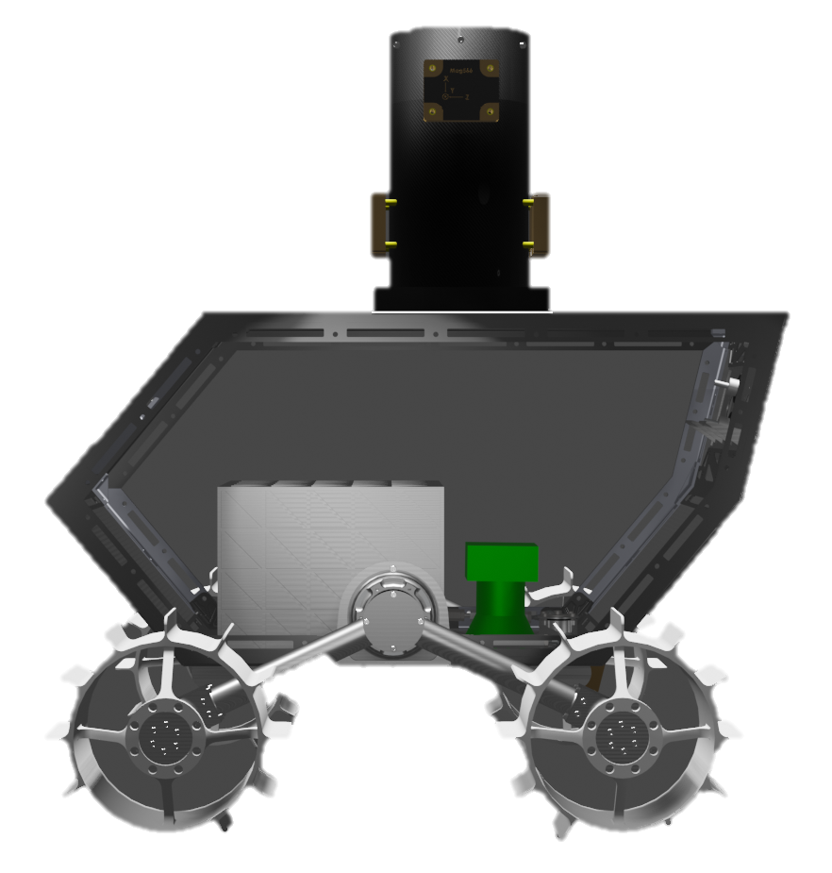
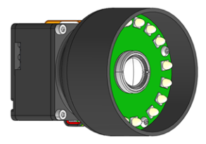

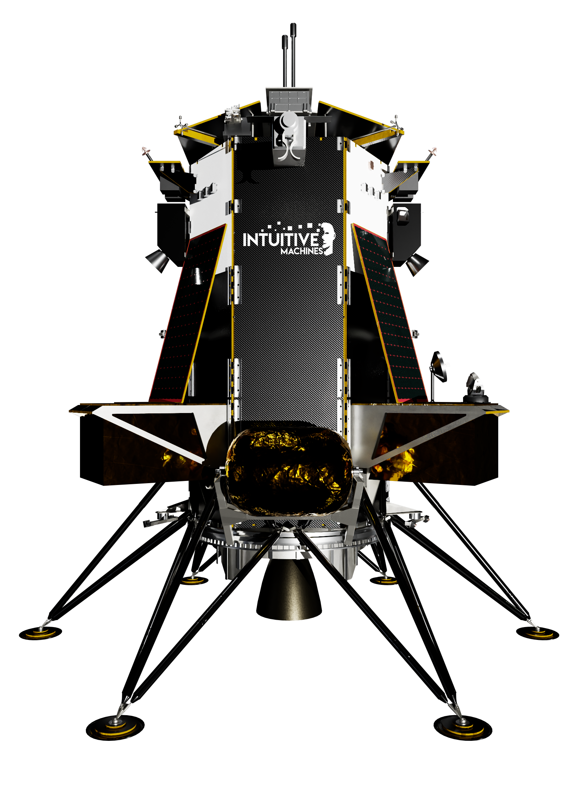

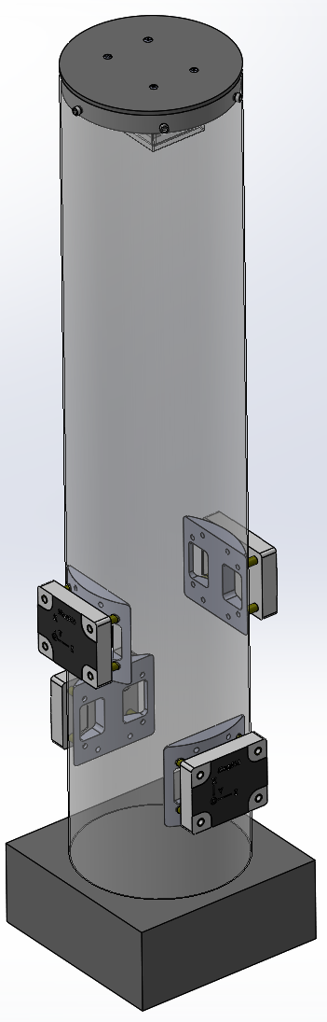
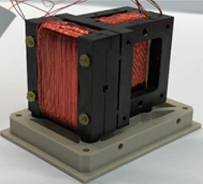
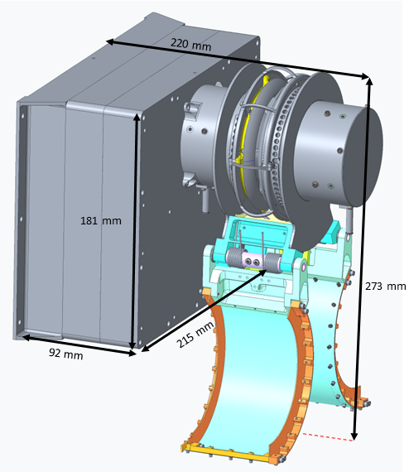
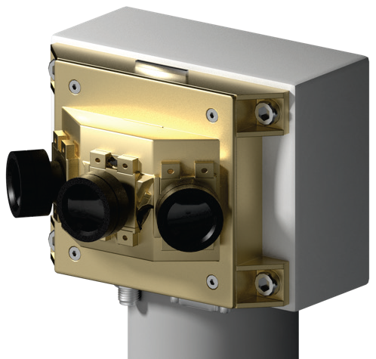




Lunar Vertex Payload
Instrumented Rover
Vector Magnetometer Rover (VMR) – Measures vector magnetic field at multiple points along the traverse route.
Rover Multispectral Microscope (RMM) – Close-up imager determines regolith composition and texture/particle size.
Lander Instruments
Vector Magnetometer Lander (VML) – Ring-core fluxgate magnetometer measures vector magnetic field during cruise, descent, and at landing site.
Magnetic Anomaly Plasma Spectrometer (MAPS) – Ion and electron electrostatic analyzer characterizes incident ions and electrons.
Vertex Camera Array (VCA) – Three sets of three color cameras provide 360° field of view of landing site for geologic context and photometric study.
Commercial
Lander

