Slide 1
Remotely Sensing Bow Shock and Magnetopause Locations
M. R. Collier¹
D. G. Sibeck¹, M. Silveira², and ………..
¹NASA/GSFC
²Catholic University of America

Slide 2
Do You Want to:
1. Study the time dependence of
magnetopause reconnection?

Slide 3
Do You Want to:
1. Study the time dependence of
magnetopause reconnection?
2. Build an empirical model for the
magnetosheath?

Slide 4
Do You Want to:
1. Study the time dependence of
magnetopause reconnection?
2. Build an empirical model for the
magnetosheath?
Test global models for the solar wind-
magnetosphere interaction?

Slide 5
Do You Want to:
1. Study the time dependence of
magnetopause reconnection?
2. Build an empirical model for the
magnetosheath?
Test global models for the solar wind-
magnetosphere interaction?
Need to:
Track the dynamic BS/MP positions

Slide 6
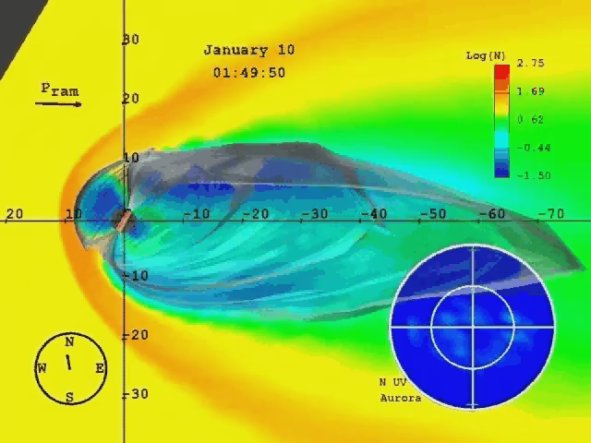
Do You Want to:
1. Study the time dependence of
magnetopause reconnection?
2. Build an empirical model for the
magnetosheath?
Test global models for the solar wind-
magnetosphere interaction?
Need to:
Track the dynamic BS/MP positions

Slide 7
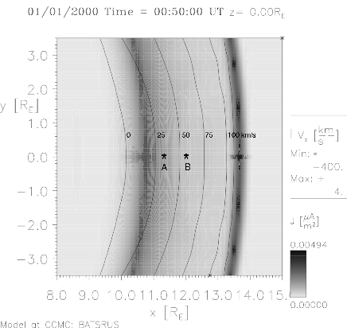
Vx Varies Linearly Across the Dayside Magnetosheath
Along the Sun-Earth Line At most dayside locations
Velocity Contours
MP BS Current Layers
0 V_{SW}/4

Slide 8
Vx Varies Linearly Across the Dayside Magnetosheath
Along the Sun-Earth Line Velocity measurements at two points give
Vx = 0 intercept (magnetopause)
Vx = Vsw/4 intercept (bow shock)
*
*

Slide 9
Track BS and MP
Bow
Shock
Southward IMF turning
Erosion
Substorm flux return
The proposed method underestimates
bow shock and magnetopause locations
but accurately estimates amplitude of
their motion→
Method is a success!
Swd IMF
Turning
Substorm
Onset
MPause

Slide 10
Back up slides

Slide 11
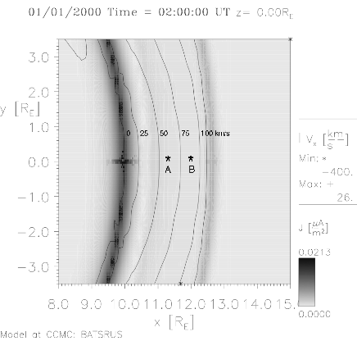
Magnetosheath: J and V_{X} for IMF B_{Z} < 0
Figure 2b. Dayside currents (grey shading) and
velocity components along the Sun-Earth line
(gradients) for southward IMF conditions. Currents
at the bow shock are weaker than those in the
at the magnetopause. The velocity gradient is nearly
linear from the magnetopause to the bow shock.
Probes A and B are at (x, y, z) = (11.25, 0, 0
and (12, 0, 0) R_{E}, respectively.

Slide 12
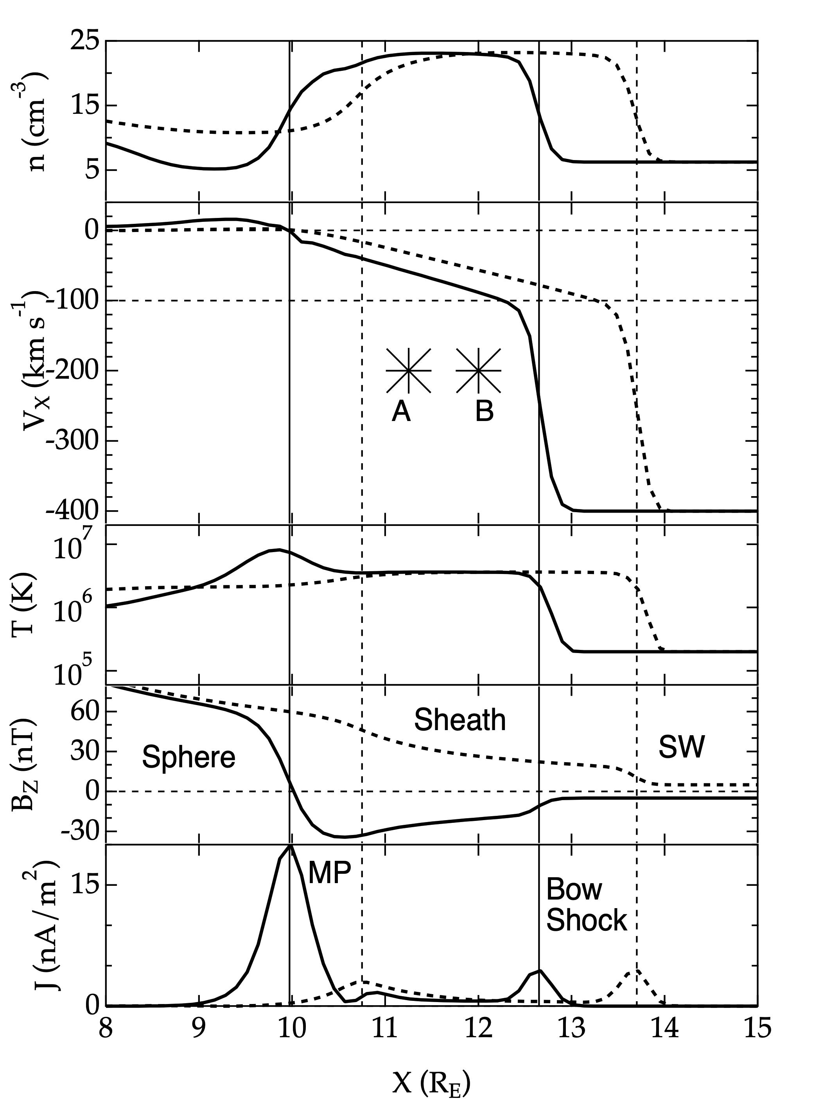
Magnetic field and plasma profiles along the Sun-Earth line
Figure 3. Unlike other parameters (e,g., n, T, or B_{Z}),
the component of the velocity along the sun-Earth line
varies nearly linearly from known values at the
subsolar magnetopause/depletion layer to known
values at the subsolar bow shock for both northward
(dashed line) and southward IMF (solid line)
conditions. Both the bow shock and magnetopause
move earthward when the IMF turns from northward
(dashed vrtical lines) to southward (solid vertical
lines). Asterisks indicate the locations of probes A and
B at (x, y, z) = (11.25, 0, 0) and (12.0, 0, 0) R_{E},
respectively.
In this run, n_{SW} = 5 cm⁻³, V_{SW} = 400 km s⁻¹, and T_{iSW} =
2x10⁵ K. Parameters for northward IMF are taken at
0100 UT in the simulation run, whilst those for
southward IMF orientation are taken at 0200 UT.

Slide 13
Results (1)
Two point (e. g., probe A and B measurements of the velocity component along the Sun-Earth line) define a line. We are interested in determining the distances from Earth where this line passes through V_{X} = 0 km/s (the magnetopause) and 0.25 V_{SW} (= 100 km/s at the bow shock in this case).

Slide 14
Results (2)
Figure 3. Observations at Probes A (solid) and B (dashed) as a function of time following a southward IMF turning at 0100 UT. The turning first passes spacecraft A (further from Earth) and then B (closer to Earth). Once it encounters the magnetopause, the entire magnetosheath gradually shifts Earthward up until 0200 UT. As a result, antisunward velocities increase. At 0200 UT there is a massive substorm onset in the magnetotail (not shown) that returns magnetic flux to the dayside magnetosphere and causes the bow shock, magnetopause, and entire magnetosheath to gradually shift outward (despite the continued southward IMF orientation). Antisunward velocities gradually decrease. Note that there is always a strong gradient in plasma velocity between Probe A and B. This gradient provides the information needed to determine the locations of the bow shock and magnetopause. The density spikes shortly after 0100 UT maintain pressure balance when the IMF abruptly shifts from 5 nT northward to -5 nT southward.

Slide 15
Results (3)
Figure 3. Time histories
at spacecraft A and B in the
magnetosheath following
a southward IMF turning.
Note the gradient in Vx.

Slide 16
Results (5)
Figure 4. Concerning the bow shock
The + curve shows the location of the bow shock as determined from the peak current.
The dotted black curve shows the location of the bow shock determined from the velocity gradient.
The predicted bow shock locations lies a fixed distance earthward from that in the simulation results.

Slide 17
Results (6)
Figure 4. Concerning the magnetopause. The X curve shows the location of the peak current density: this is the depletion layer before 0100 UT when the IMF is northward and the magnetopause after 0100 UT when the IMF is southward. The dashed black curve shows the topological magnetopause in the simulation. This lies earthward from the peak current when the IMF is northward, but at the same location as the current layer when the IMF is southward. The dotted black curve shows the magnetopause location determined from the velocity gradient. It lies on top of the topological magnetopause when the IMF points northward, slightly earthward when the IMF points southward.

Slide 18
Conclusion (1)
We have shown how the locations of the subsolar bow shock and magnetopause can be determined from two-point measurements of the component of the plasma velocity along the Sun-Earth line in the subsolar magnetosheath.
The result is possible because velocities vary nearly linearly from known values of 0 at the magnetopause to 0.25 V_{SW} at the bow shock.

Slide 19
Conclusion (2)
The next steps are:
1. To study real events (THEMIS, MMS, Geotail, Cluster observations).
2. To invoke the Soucek and Escoubet [2021] magnetosheath plasma flow model and emply observations from spacecraft at locations away from the Sun-Earth line.
3. To improve the method to predict exact locations of the magnetopause and bow shock for both northward and southward IMF orientations and understand the oscillatory motion seen during southward IMF conditions in Figure 4.

Slide 20
Acknowledgments
Simulation results were obtained from the University of Michigan's BATS-R-US model run at NASA GSFC's Community Coordinated Modeling Center.
We acknowledge the help received from both organizations with gratitude.

