Slide 1
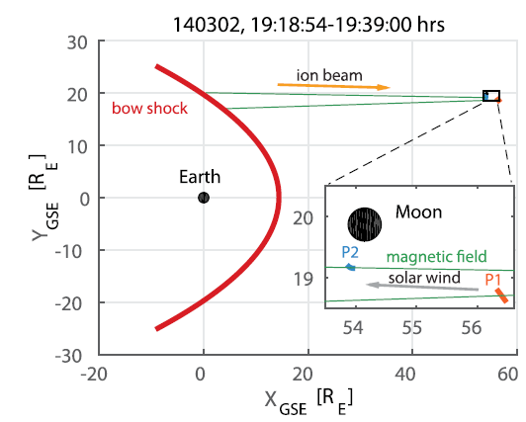
The Early-phase Growth of ULF Waves in the Ion Foreshock observed in a Hybrid-Vlasov Simulation
Kun Zhang, Seth Dorfman, Urs Ganse, Lucile Turc and Chen Shi
bow shock
ARTEMIS observations (Dorfman et al., 2017)
solar wind
IMF
beam (t=t1)
ion beam (t=t0)
Earth
k
Wave growth convection
wave observation
(t=t1)
wave starts
(t=t0)
ARTEMIS

Slide 2
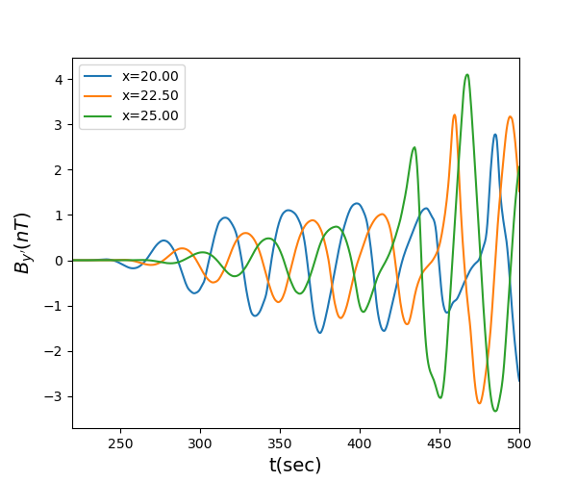
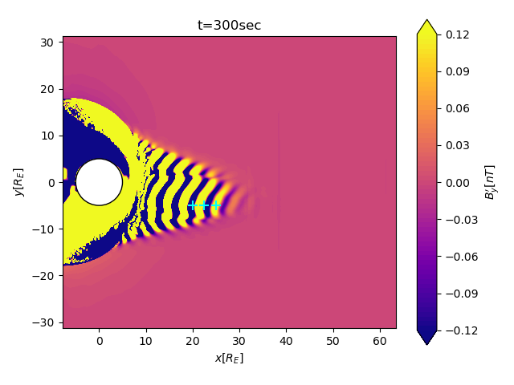
Vlasiator (hybrid-Vlasov simulation)
Can resolve ion kinetic physics
Electrons as charge-neutralizing fluid
IMF: 5nT, v_{sw}=600 km/s, Mach number=10
Provides both field and particle (ion) data throughout the simulation domain
Determine the wave speed
26.5s
By’ intensity map
wave frame
Correlation analysis shows 26.5 sec lag between signals
virtual s/c

Slide 3
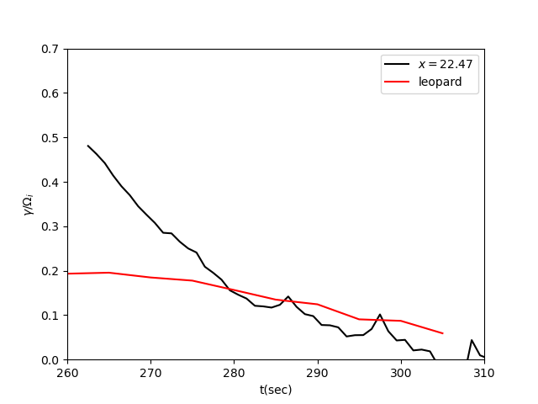
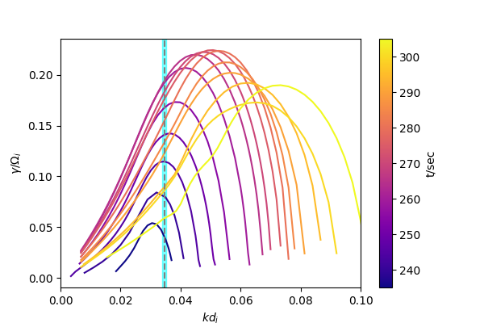
Wave growth observed in the wave frame compared to theoretic prediction
Dispersion by LEOPARD (Astfalk & Jenko, 2017)
From ion distribution obtained in the wave frame
Growth rate
Observation in the wave frame
Prediction by ion distribution
Observed k
The observed growth rate agrees with theoretic prediction at later times (t>~280 sec)
The discrepancy at the beginning is not understood yet.

